Slide 1
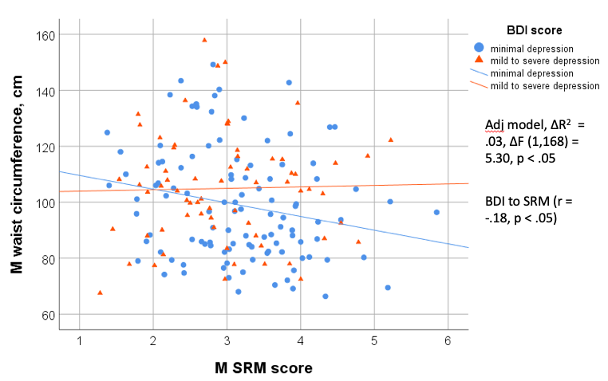
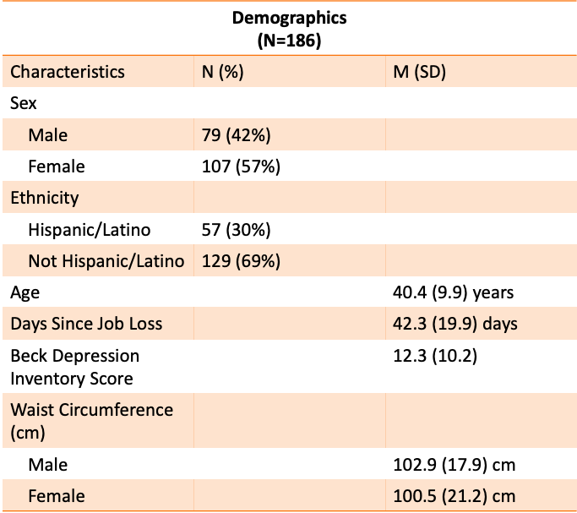
Social Rhythm Instability is Associated with Abdominal Adiposity after Involuntary Job Loss
Apolinar, G.¹, Kobayashi, U.¹, Thomson, C. ¹, Quan, S. ^{1,2,3}, Silva, G. ¹, Glickenstein, D. ¹, Haynes, P.L.¹
¹University of Arizona, Tucson, AZ, ²Brigham and Women’s Hospital, ³Harvard Medical School
INTRODUCTION
RESULTS
Employment is an important aspect of social rhythm, the variability in habitual daily behaviors.¹
Unemployment can initiate economic hardship and psychological distress; it is also associated with significant negative obesity-related health outcomes.²
Little is known about daily routine, depression, and obesity in individuals who have recently lost their jobs.
We hypothesized that individuals with unstable social rhythms after job loss would have more abdominal adiposity than individuals with more consistent social rhythms. We also hypothesized that this relationship would vary as a function of depressive symptoms.
SRM score x Depression Predicts Waist Circumference (Cross-sectional)
PARTICIPANTS
Cross-sectional baseline data gathered from the ongoing Assessing Daily Activity Patterns through occupational Transitions (ADAPT) study.³
N=186 recently unemployed individuals
Inclusion criteria: Involuntary job loss in last 3 months, worked ≥ 6 months at previous job, ≥ 30 hrs/week, other weight and sleep related behaviors
A significant interaction for SRM score x BDI was found when predicting waist circumference.
Results demonstrated that SRM had a negative relationship with waist circumference, only at lower levels of BDI.
SUMMARY AND DISCUSSION
A less consistent daily routine was associated with a larger waist circumference among individuals with minimal depressive symptoms.
These findings are the first to demonstrate a relationship between social rhythm stability and abdominal adiposity in adults at high risk for central obesity.
Results highlight the moderating role of depression in obesity prevention.
Future prospective analysis is necessary to examine causal pathways.
METHODS
Measures
Structured demographic interview
Waist circumference (cm)
Beck Depression Inventory (BDI)⁴
Social Rhythm Metric (SRM)⁵
REFERENCES AND ACKNOWLEDGEMENTS
Jahoda, M., Employment and Unemployment. 1982: Cambridge University Press.
Margerison-Zilko, C., et al., Health impacts of the great recession: a critical review. Current epidemiology reports, 2016. 3(1): p. 81-91.
Haynes, P.L., et al., Longitudinal assessment of daily activity patterns on weight change after involuntary job loss: the ADAPT study protocol. BMC public health, 2017. 17(1): p. 793.
Beck, A.T., et al., An inventory for measuring depression. Archives of general psychiatry, 1961. 4(6): p. 561-571.
Monk, T.H., et al., The Social Rhythm Metric (SRM): measuring daily social rhythms over 12 weeks. Psychiatry research, 1991. 36(2): p. 195-207.
Data Analysis
Linear regression predicting waist circumference, controlling for age, gender, ethnicity, and days since job loss.
Examination of SRM index x BDI interaction and each main effect.
This project was supported by a grant from National Heart, Lung and Blood Institute (Grant # R01HL117995-01A1)

