Slide 1

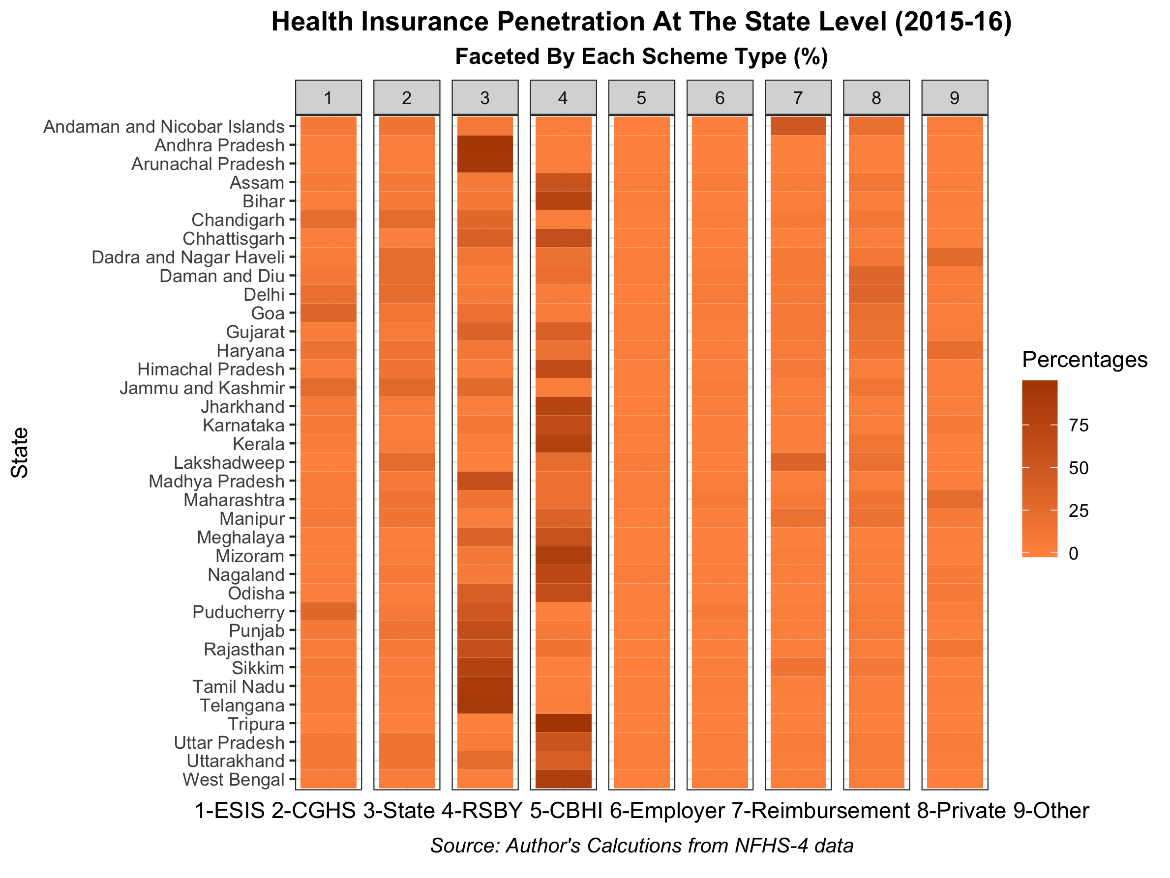
Impact of wealth and other determinants on health insurance enrollment in India: An empirical analysis of National Family Health Survey-4 (2015-16)
Preshit Ambade¹, Dr. Elizabeth Calhoun², Dr. Tauhidur Rahman³,
Dr. Smita Pakhale⁴, Dr. Joe Gerald¹
1Mel and Enid Zuckerman College of Public Health, University of Arizona, Tucson, AZ. 2Center for Population Science and Discovery, University of Arizona, Tucson, AZ. 3Department of Agricultural and Resource Economics, University of Arizona, Tucson, Az. 4Department of Medicine, University of Ottawa, Ontario, Canada.
Background
Results
Figure-3: Relative Risk Ratios for enrolling under different health insurance categories (2015-16)
India have adopted path of health insurance to achieve the objectives of Universal Health Coverage (UHC).
India launched Pradhan Mantri Jan Aarogya Yojana (PM-JAY) in 2018 aiming to cover 10 million households.¹
Unaffordability of insurance is a big concern.² However, low-income households consider health insurance as an important product.³⁻⁵
Besides federal scheme, 17 states and 4 Union Territories have own health insurance schemes.⁶
Marginalized communities are benefitted because of the government schemes;^{6,7} however, miss-targeting and enrollment issues are reported previously.⁷⁻⁹
The odds of having health insurance decreases with increasing wealth (second-lowest OR-0.96, p-value>0.05; middle OR-0.84, p-value<0.01; fourth OR-0.81, p-value<0.001; highest OR-1.10, p-value>0.05).
Interaction effect of religion, caste, and place of residence are significant.
Muslims have lesser odds of having health insurance.
Employer-based: Scheduled Tribes with higher assets have higher enrollment
Publicly funded: Poor from marginalized caste have higher enrollment
Private: higher asset groups have higher probability
Figure-2: Odd ratios for health insurance enrollments (2015-16)
Objective
To evaluate impact of asset holding and its interaction with other socio-economic indicators which affects health insurance enrollment for a household.
Methods
We use data from the 2015-16 National Family Health Survey and logit model to estimate the association between household’s wealth status and health insurance enrollment for 461,699 households.
Interaction effect of religion, caste, and place of residence also estimated.
Further, we estimate relative risk ratios for enrollments in employer-based, publicly funded, and private health insurance programs versus having no health insurance.
Figure-1: Statewide Health Insurance Penetration in India 2015-16*
Conclusion
References
Asset holding play significant role in health insurance enrollment decisions
Access to health insurance for the poor is increased.
Poor households from marginalized caste groups have gained access to public schemes; however, wealth still determines the access.
Special efforts to reach out to the most vulnerable populations, i.e., poorest marginalized caste groups, Muslims and urban poor needs to be taken.
National Health Agency. (2018). Pradhan Mantri Jan Arogya Yojna. PM-JAY - Ayushman Bharat. Retrieved from https://www.pmjay.gov.in/
Thomas, T. K. (2016). Role of Health insurance in enabling universal health coverage in India: A critical review. Health Services Management Research, 29(4), 99-106.
Dror, I. (2007). Demystifying Micro Health Insurance Package Design-Choosing Healthplans All Together (Chat). Microfinance Insights, 4, 17-19.
Gumber, A., & Kulkarni, V. (2000). Health insurance for informal sector: case study of Gujarat. Economic and Political Weekly, 3607-3613.
Binnendijk, E., Dror, D. M., Gerelle, E., & Koren, R. (2013). Estimating Willingness-to-Pay for health insurance among rural poor in India by reference to Engel's law. Social Science & Medicine, 76, 67-73.
Keshri, V. R., & Ghosh, S. (2019). Health Insurance for Universal Health Coverage in India: A Critical Examination. In Working Paper. Patna, Bihar, India: The Center for Health Policy and Asian Development Research Institute.
Ravi, S., Ahluwalia, R., & Bergkvist, S. (2016). Health and Morbidity in India (2004-2014) (092016). Retrieved from New Delhi:
Ghosh, S., & Datta-Gupta, N. (2017). Targeting and effects of rashtriya swasthya bima yojana on access to care and financial protection. Econ Polit Wkly, 52, 61-70.
Nandi, A., Ashok, A., & Laxminarayan, R. (2013). The socioeconomic and institutional determinants of participation in India’s health insurance scheme for the poor. PloS one, 8(6), e66296.
Contact Details:
Preshit N. Ambade, DrPH Candidate,
Mel and Enid Zuckerman College of Public Health,
University of Arizona, Tucson, AZ (USA).
Cell No.: (520) 445-5474 E-mail : preshitambade@email.arizona.edu

